Slide 1
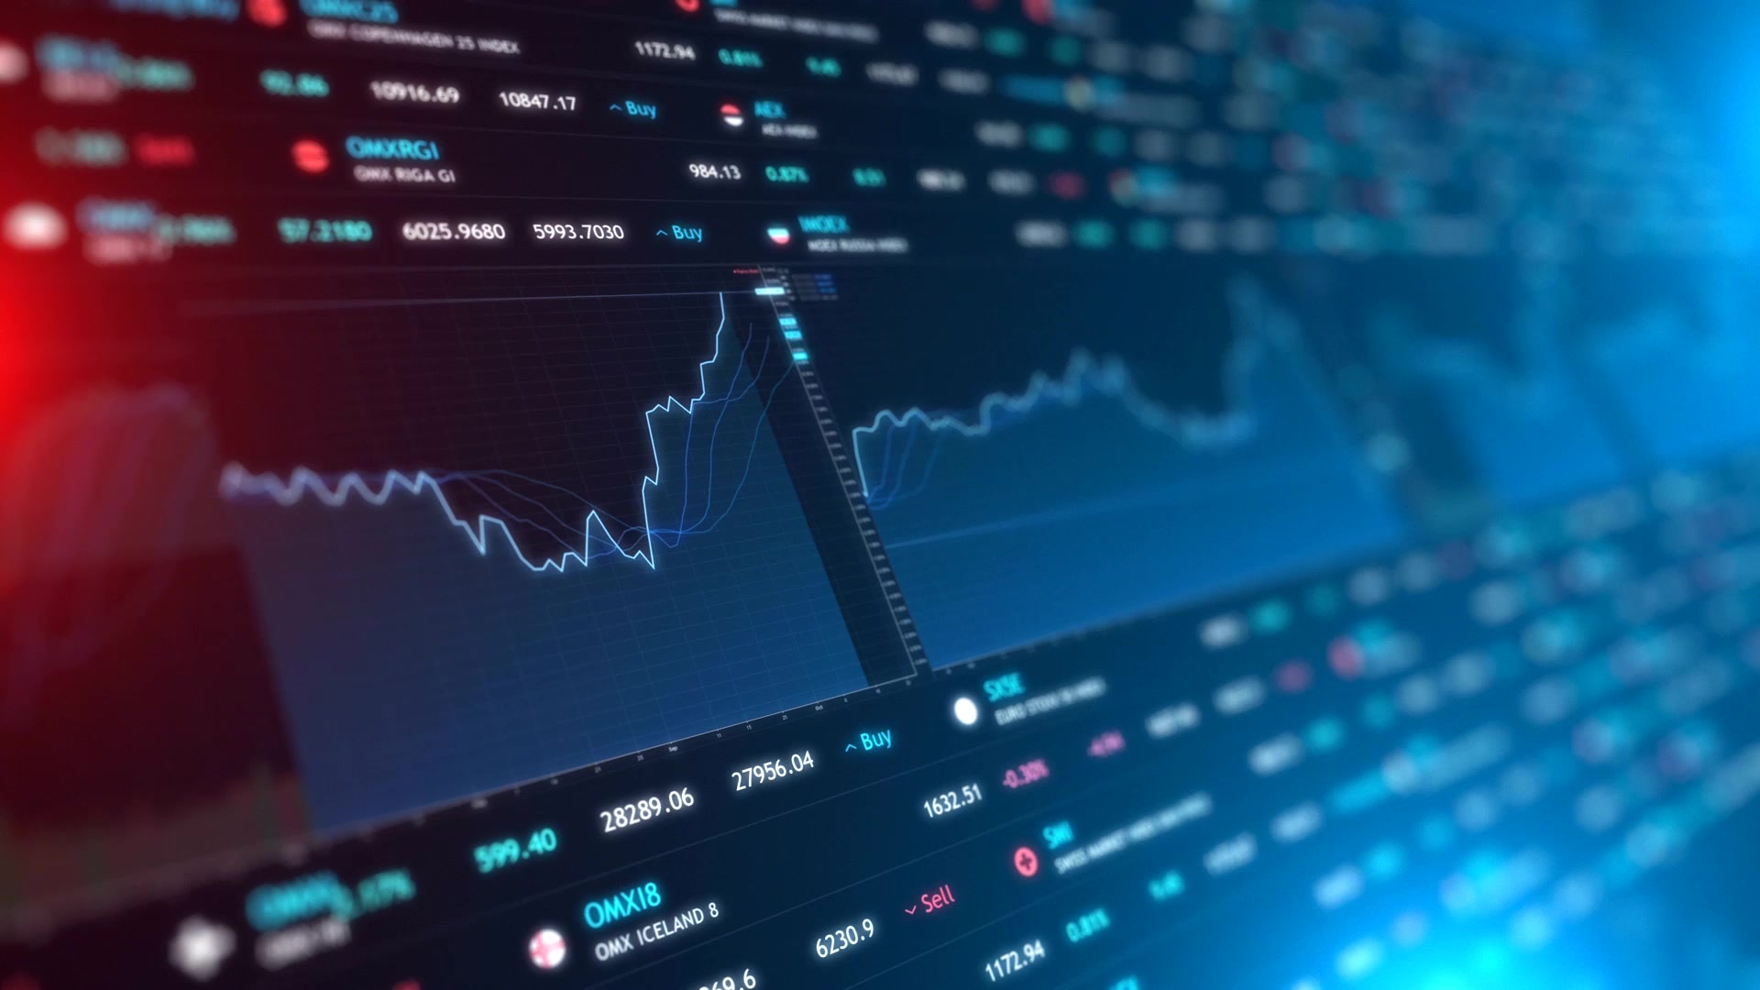
Quantitative Trading with Deep Reinforcement Learning
Team: Farhanur Rahim Ansari and Shubhi Saxena

Slide 2
Goal
Implement and use a deep reinforcement learning technique to perform portfolio optimization and stock trading to maximize returns and profit.

Slide 3
Problem Statement
Complex and huge : The financial market is a complex system influenced by several factors like news, economy etc.
Partial Observable Environment : Difficult to comprehend the full state at any time
End Goal : Maximize returns based on estimates of potential return and risk.
This makes portfolio optimization and stock trading an effective application of Reinforcement Learning.

Slide 4
Technical indicators
Sharpe Ratio
Measures the performance of an investment compared to a risk-free asset
Represents the additional amount of return that an investor receives per unit of increase in risk
Sharpe Ratio = (Return on Investment – Risk-free return) / (standard deviation of investment)
Dow Jones Industrial Average (DJIA)
Is a stock market index gauging the performance of the industrial sector
Include 30 companies and averaged their values by following a specific formula

Slide 5
Why Deep Reinforcement Learning (DRL)?
Modern Portfolio Theory (MPT) not enough : calculated only based on stock returns and highly sensitive to outliers.
Markov Decision Process : stock trading is a continuous process, can be modeled as MDP.
Optimization Problem : DRL solves maximizing the expected total reward from future actions.
Multidimensional & large dataset : DRL approximates the Q value with a neural network

Slide 6
Trading Environment
States
account balance – money in the trading account
Date, Open, High, Low, Close, Adjusted Close, Volume
relevant stock technical data
Actions
Buy - Perform and record buy transactions
Sell - Perform and record sell transactions
Rewards
Total asset gain/loss by the end of each day
Episode
End of episode is defined when timestamp reaches last day in feature data
Reset environment after each episode

Slide 7
Deep deterministic policy gradient (ddpg)
Actor-critic based algorithm
Actor – Proposes an action given a state, Critic – predicts if action is good/bad given a state and an action
Combines both Q-learning and policy gradient frameworks
Uses neural networks as function approximators
Learns directly from the observations through policy gradient

Slide 8
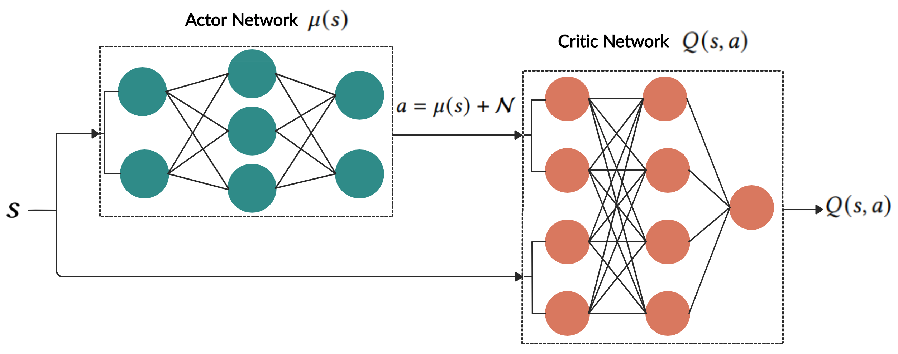
Ddpg Architecture

Slide 9
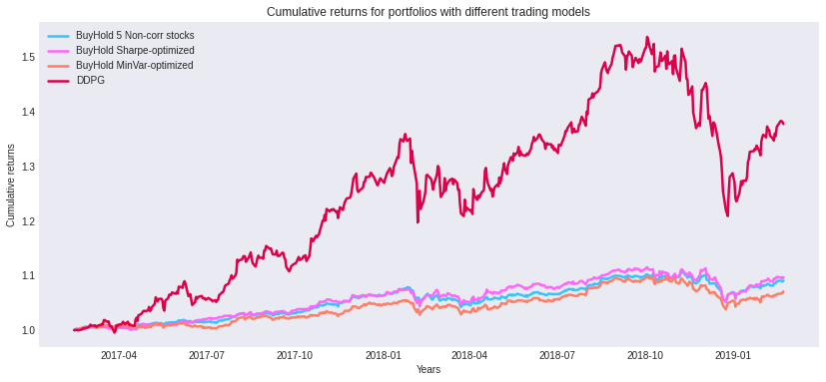
Result – DDPG VS MPT

Slide 10
Future work
Comparing DDPG performance against the benchmark DJIA model
Implementing a supervised deep learning approach using Recurrent Nural Network (RNN) and comparing it with DDPG result
Trying our approach on different portfolios

Slide 11
Thank You!

